Slide 1
Informed search algorithms
Chapter 4

Slide 2
Outline
Informed = use problem-specific knowledge
Which search strategies?
  Best-first search and its variants
Heuristic functions?
  How to invent them
Local search and optimization
  Hill climbing, local beam search, genetic algorithms,…

Slide 3
Previously: tree-search
function TREE-SEARCH(problem,fringe) return a solution or failure
fringe ← INSERT(MAKE-NODE(INITIAL-STATE[problem]), fringe)
loop do
if EMPTY?(fringe) then return failure
node ← REMOVE-FIRST(fringe)
if GOAL-TEST[problem] applied to STATE[node] succeeds
then return SOLUTION(node)
fringe ← INSERT-ALL(EXPAND(node, problem), fringe)
A strategy is defined by picking the order of node expansion

Slide 4
Best-first search
General approach of informed search:
  Best-first search: node is selected for expansion based on an evaluation function f(n)
Idea: evaluation function measures distance to the goal.
  Choose node which appears best
Implementation:
  fringe is queue sorted in decreasing order of desirability.
  Special cases: greedy search, A* search

Slide 5
A heuristic function
[dictionary]“A rule of thumb, simplification, or educated guess that reduces or limits the search for solutions in domains that are difficult and poorly understood.”
  h(n) = estimated cost of the cheapest path from node n to goal node.
  If n is goal then h(n)=0
  How to design heuristics? Later..

Slide 6
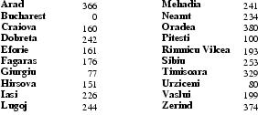
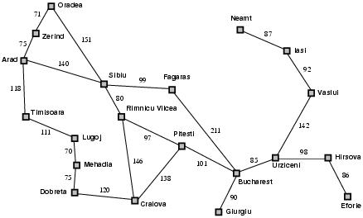
Romania with step costs in km
h_{SLD}=straight-line distance heuristic.
h_{SLD} can NOT be computed from the problem description itself
In this example f(n)=h(n)
  Expand node that is closest to goal
  = Greedy best-first search

Slide 7

Romania with step costs in km

Slide 8
Greedy best-first search
Evaluation function f(n) = h(n) (heuristic)
= estimate of cost from n to goal
e.g., h_{SLD}(n) = straight-line distance from n to Bucharest
Greedy best-first search expands the node that appears to be closest to goal

Slide 9
Greedy search example
Arad (366)
Assume that we want to use greedy search to solve the problem of travelling from Arad to Bucharest.
The initial state=Arad

Slide 10

Greedy best-first search example

Slide 11

Greedy best-first search example

Slide 12

Greedy best-first search example

Slide 13

Greedy best-first search example

Slide 14
Properties of greedy best-first search
Complete? No – can get stuck in loops, e.g., Iasi → Neamt → Iasi → Neamt →
Time? O(b^{m}), but a good heuristic can give dramatic improvement
Space? O(b^{m}) -- keeps all nodes in memory
Optimal? No, same as DF-search

Slide 15
A* search
Best-known form of best-first search.
Idea: avoid expanding paths that are already expensive.
Evaluation function f(n)=g(n) + h(n)
  g(n) the cost (so far) to reach the node.
  h(n) estimated cost to get from the node to the goal.
  f(n) estimated total cost of path through n to goal.

Slide 16
A* search
A* search uses an admissible heuristic
  A heuristic is admissible if it never overestimates the cost to reach the goal
  Are optimistic
    Formally:
    1. h(n) <= h*(n) where h*(n) is the true cost from n
    2. h(n) >= 0 so h(G)=0 for any goal G.
    e.g. h_{SLD}(n) never overestimates the actual road distance

Slide 17
Romania example

Slide 18

A* search example

Slide 19

A* search example

Slide 20

A* search example

Slide 21

A* search example

Slide 22

A* search example

Slide 23

A* search example

Slide 24
Admissible heuristics
A heuristic h(n) is admissible if for every node n,
h(n) ≤ h*(n), where h*(n) is the true cost to reach the goal state from n.
An admissible heuristic never overestimates the cost to reach the goal, i.e., it is optimistic
Example: h_{SLD}(n) (never overestimates the actual road distance)
Theorem: If h(n) is admissible, A* using TREE-SEARCH is optimal

Slide 25
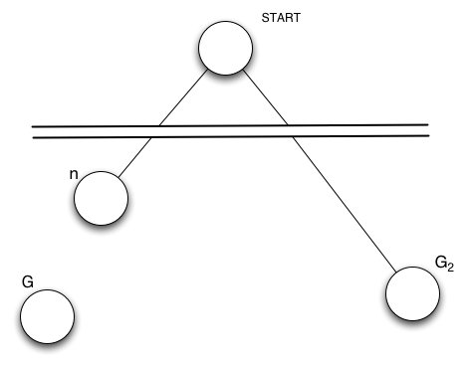
Optimality of A*(standard proof)
Suppose suboptimal goal G₂ in the queue.
Let n be an unexpanded node on a shortest to optimal goal G.
    f(G₂ ) = g(G₂ ) since h(G₂ )=0
    > g(G) since G₂ is suboptimal
    >= f(n) since h is admissible
    Since f(G₂) > f(n), A* will never select G₂ for expansion

Slide 26
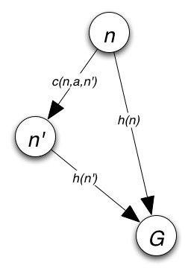

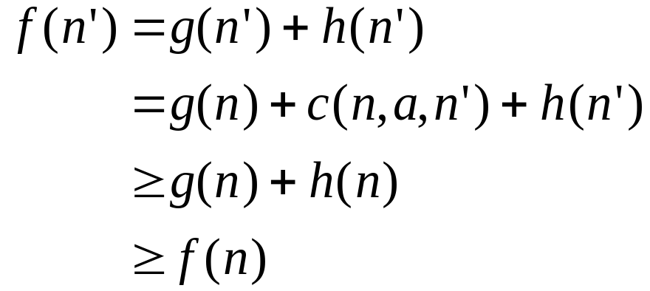
Consistency
A heuristic is consistent if
If h is consistent, we have
i.e. f(n) is nondecreasing along any path.

Slide 27
Properties of A*
Complete? Yes (unless there are infinitely many nodes with f ≤ f(G) )
Time? Exponential
Space? Keeps all nodes in memory
Optimal? Yes

Slide 28
Improving the memory cost for A*
(Further details found in 1st Edition of your text)
Algorithm;
  set cutoff, h(start node)
    i.e., an initial estimate of distance to goal
Do pure depth-first search, stopping when f(n) > cutoff
    if succeed, done.
    if fail, cutoff+minimum-amount-by which cutoff-was-exceed;iterate step
This is called “iterative deepening A*” (IDA)

Slide 29
Iterative Deepening A* (IDA)
Always finds an optimal solution
Uses space linear in solution depth
Is asymptotically no slower that A*
Assuming a tree structure space, so we don’t have to check for cycles
Or at least, that cycles are few and long
So, IDA* is about as good as we can do, given an (admissible) heuristic function.

Slide 30
IDA* vs A*
In practice using a heuristic like the manhattan distance, A* can’t solve the 15 puzzle because machine run out of memory, IDA*
Empirically, IDA* generates more nodes than A*, but surprisingly, it often runs faster!
  it incurs less overhead per node, and it is easier to implement (since it is essentially depth-first as opposed to breadth-first)
  e.g., IDA* finds 12 step solution to 8-puzzle problem very quickly expanding 39 nodes
A lot depends on the problem space
  For example, in a space where there are only a few values for the heuristic function (e.g.,, the n-puzzle), IDA* works well, In a case in which each state has a different value (e.g., finding the paths between locations), IDA* will have to expand the square of of the number of nodes A* will expand

Slide 31
Learning to search better
All previous algorithms use fixed strategies.
Agents can learn to improve their search by exploiting the meta-level state space.
  Each meta-level state is a internal (computational) state of a program that is searching in the object-level state space.
  In A* such a state consists of the current search tree
A meta-level learning algorithm from experiences at the meta-level.

Slide 32

Heuristic functions
E.g for the 8-puzzle
  Avg. solution cost is about 22 steps (branching factor +/- 3)
  Exhaustive search to depth 22: 3.1 x 10¹⁰ states.
  A good heuristic function can reduce the search process.

Slide 33

Admissible heuristics
E.g., for the 8-puzzle:
h₁(n) = number of misplaced tiles
h₂(n) = total Manhattan distance
(i.e., no. of squares from desired location of each tile)
h₁(S) = ?
h₂(S) = ?

Slide 34
Admissible heuristics
E.g., for the 8-puzzle:
h₁(n) = number of misplaced tiles
h₂(n) = total Manhattan distance
(i.e., no. of squares from desired location of each tile)
h₁(S) = 8
h₂(S) = 3+1+2+2+2+3+3+2 = 18

Slide 35
Inventing admissible heuristics
Admissible heuristics can be derived from the exact solution cost of a relaxed version of the problem:
  Relaxed 8-puzzle for h₁ : a tile can move anywhere
    As a result, h₁(n) gives the shortest solution
  Relaxed 8-puzzle for h₂ : a tile can move to any adjacent square.
    As a result, h₂(n) gives the shortest solution.
The optimal solution cost of a relaxed problem is no greater than the optimal solution cost of the real problem.

Slide 36
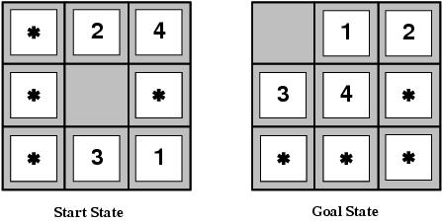
Inventing admissible heuristics
Admissible heuristics can also be derived from the solution cost of a subproblem of a given problem.
This cost is a lower bound on the cost of the real problem.
Pattern databases store the exact solution to for every possible subproblem instance.
  The complete heuristic is constructed using the patterns in the DB

Slide 37
Inventing admissible heuristics
Another way to find an admissible heuristic is through learning from experience:
  Experience = solving lots of 8-puzzles
  An inductive learning algorithm can be used to predict costs for other states that arise during search.

Slide 38
Local search and optimization
Previously: systematic exploration of search space.
  Path to goal is solution to problem
In many optimization problems, the path to the goal is irrelevant; the goal state itself is the solution
Generally, for some problems path is irrelevant.
  E.g 8-queens
Different algorithms can be used
  Local search

Slide 39

Example: n-queens
Put n queens on an n × n board with no two queens on the same row, column, or diagonal

Slide 40
Local search and optimization
Local search= use single current state and move to neighboring states.
Advantages:
  Use very little memory
  Find often reasonable solutions in large or infinite state spaces.
Are also useful for pure optimization problems.
  Find best state according to some objective function.
  e.g. survival of the fittest as a metaphor for optimization.

Slide 41
Hill-climbing search
It terminates when a peak is reached.
Hill climbing does not look ahead of the immediate neighbors of the current state.
Hill-climbing chooses randomly among the set of best successors, if there is more than one.
Hill-climbing a.k.a. greedy local search

Slide 42

Hill-climbing search

Slide 43

Hill-climbing search
Problem: depending on initial state, can get stuck in local maxima.

Slide 44
Hill-climbing example
8-queens problem (complete-state formulation).
Successor function: move a single queen to another square in the same column.
Heuristic function h(n): the number of pairs of queens that are attacking each other (directly or indirectly).

Slide 45

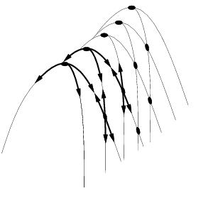
Drawbacks
Ridge = sequence of local maxima difficult for greedy algorithms to navigate
Plateaux = an area of the state space where the evaluation function is flat.
Gets stuck 86% of the time.

Slide 46
Hill-climbing variations
Stochastic hill-climbing
  Random selection among the uphill moves.
  The selection probability can vary with the steepness of the uphill move.
First-choice hill-climbing
  stochastic hill climbing by generating successors randomly until a better one is found.
Random-restart hill-climbing
  Tries to avoid getting stuck in local maxima.

Slide 47
Simulated annealing
Escape local maxima by allowing “bad” moves.
  Idea: but gradually decrease their size and frequency.
Origin; metallurgical annealing
Bouncing ball analogy:
  Shaking hard (= high temperature).
  Shaking less (= lower the temperature).
If T decreases slowly enough, best state is reached.
Applied for VLSI layout, airline scheduling, etc.

Slide 48
Simulated annealing
Tries to fix the weakness with hill-climbing methods where the search
gets stuck in a local maximum.
Basic Idea: Instead of picking the best move, pick a random move;
if the successor state obtained by this move is an improvement over
the current state, then do it. Otherwise, make the move with some
probability < 1. The probability decreases exponentially with the
badness of the move.
Define a temperature function that decreases over time. At each move,
compute the current temperature T, and use T to determine the probability
with which to allow a move to a worse state. In the limit, T goes to 0 zero
at which point the method is doing hill-climbing, hence the probability
is proportional to T.

Slide 49
Simulated annealing
function SIMULATED-ANNEALING( problem, schedule) return a solution state
input: problem, a problem
schedule, a mapping from time to temperature
local variables: current, a node.
next, a node.
T, a “temperature” controlling the probability of downward steps
current ← MAKE-NODE(INITIAL-STATE[problem])
for t ← 1 to ∞ do
T ← schedule[t]
if T = 0 then return current
next ← a randomly selected successor of current
∆E ← VALUE[next] - VALUE[current]
if ∆E > 0 then current ← next
else current ← next only with probability e^{∆E /T}

Slide 50
Local beam search
Keep track of k states instead of one
  Initially: k random states
  Next: determine all successors of k states
  If any of successors is goal → finished
  Else select k best from successors and repeat.
Major difference with random-restart search
  Information is shared among k search threads.
Can suffer from lack of diversity.
  Stochastic variant: choose k successors at proportionally to state success.

Slide 51
Search summary
best search method is problem specific
heuristics permit us to evaluate the children, and select a most promising one
  we can even rank them in order of promise
  this lets us incorporate problem-specific knowledge into the search strategy
  note: many domains do not admit strong heuristics, so the rating of nodes might be of minimal use (but better than nothing, hopefully!)
There are books dedicated to the design of heuristic functions

